Slide 1
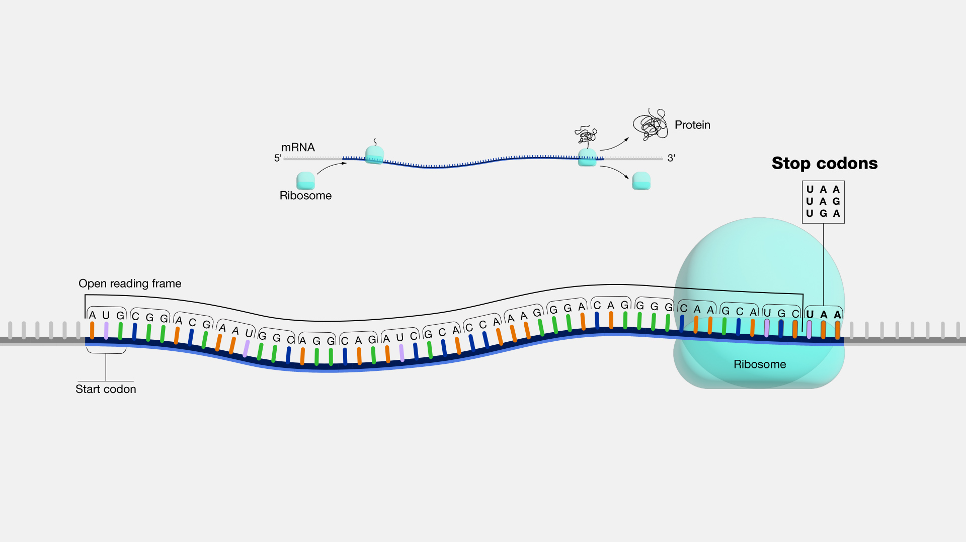
Investigating the frequency of tandem stop codons in eukaryotic & prokaryotic genomes
By Thomas Boyle
Supervised
By Wayne Aubrey
Notes:
Hello, I’m Tommy and my project is Investigating the frequency of tandem stop codons in eukaryotic & prokaryotic genomes Supervised by Wayne

Slide 2


What are stop codons?
In frame?
What can we find after the sequence ends? Tandem Stop codons!
But Why?
What are Tandem Stop Codons?
Notes:
So, what are stop codons, Stop codons are a set of three nucleotides that signal the end of protein coding sequences. There are three. TAA, TAG, TGA. They must be in frame with the start codon, so in sets of three. But why are there three stop codons to represent the end why not just one?
So, what are tandem stop codons and why do they exist,
they are extra stop codons that appear almost directly after the gene ends, it acts as a backup in case of a read through error by the ribosome. In a recent paper it was concluded that they occur in the first 12 bases after the sequences ends, the paper was called “Conservation of tandem stop codons in yeasts”

Slide 3


What are start codons?
Are their Tandem start codons here?
Can we do something similar with start codons?
Notes:
So what are Start codons, similar to stop codons they are a set of three nucleotides used to represent the start of the gene.
Similarly to the stop codons, are there tandem start codons, can we find them, and what can we find out about them, what index will they be located at, will it be the same as what’s been done for the stop codons?
Spoiler the answer is yes there are tandem start codons and an interesting pattern to observe.

Slide 4

Project significance and what do I want to achieve
Investigating the intergenic regions of DNA, it is unknown why specific tandem stop codons are used.
What data do we want to create from this project
The frequency of specific tandem stop codons based on the initial stop codon in the gene, Is there a pattern based on gene or stop/start codon usage?
What are the indexes tandem stop codons, where are they located?
GC content of the sequence
Is there a pattern to the stop codon or tandem stop codons used, what about GC content and/or the type of gene?
Notes:
So, what is the project significance and what do I indent to achieve by the end of this project.
I intent to investigate these intergenic regions of DNA containing tandem stop codons, and better understand why and how tandem stop codons are being used.
Recent studies have confirmed the presents of tandem stop codons in eukaryotic genomes but what about prokaryotic genomes? Will we find any and what kind of patterns will be found if any.
So, what exactly do I want to create from this project, well some code that is able to output a text file containing the frequency's of tandem stop codons used based on their initial stop codon, as well as the gc content. I will be able to use this information gained from various files. To look for patterns in the way these tandem stop codons are used.

Slide 5
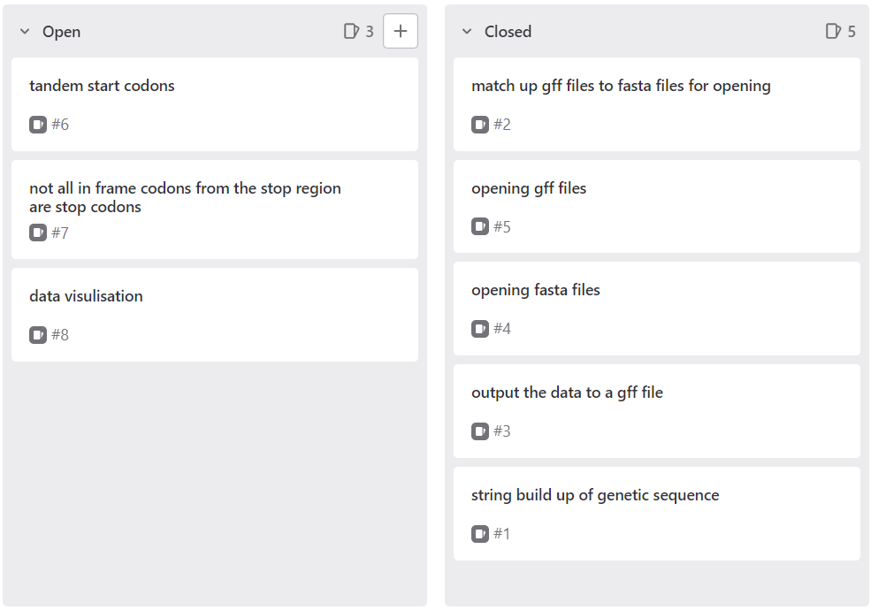
Methodologies
Kanban board from agile
Notes:
I’m using the built in gitlab Kanban board, this allows me to effectively keep track of tasks that need completing, I choose Kanban because of its visual nature, and I am more of a visual learner, and it helps me manage the workload better.

Slide 6




Programming language and IDE
Python using The pycharm IDE
Notes:
I choose to use Python mainly because of the way that I can use pythons built in dictionary data structure to store the contents of these fasta files and gff files, python is also widely used for many bioinformatics .rojects around the world and has many useful libraries that can be used for biological data processing.
I was using the sypder python ide, however it kept crashing on me, so I switched to pycharm at Wayne's suggestion, which works perfectly for me.

Slide 7
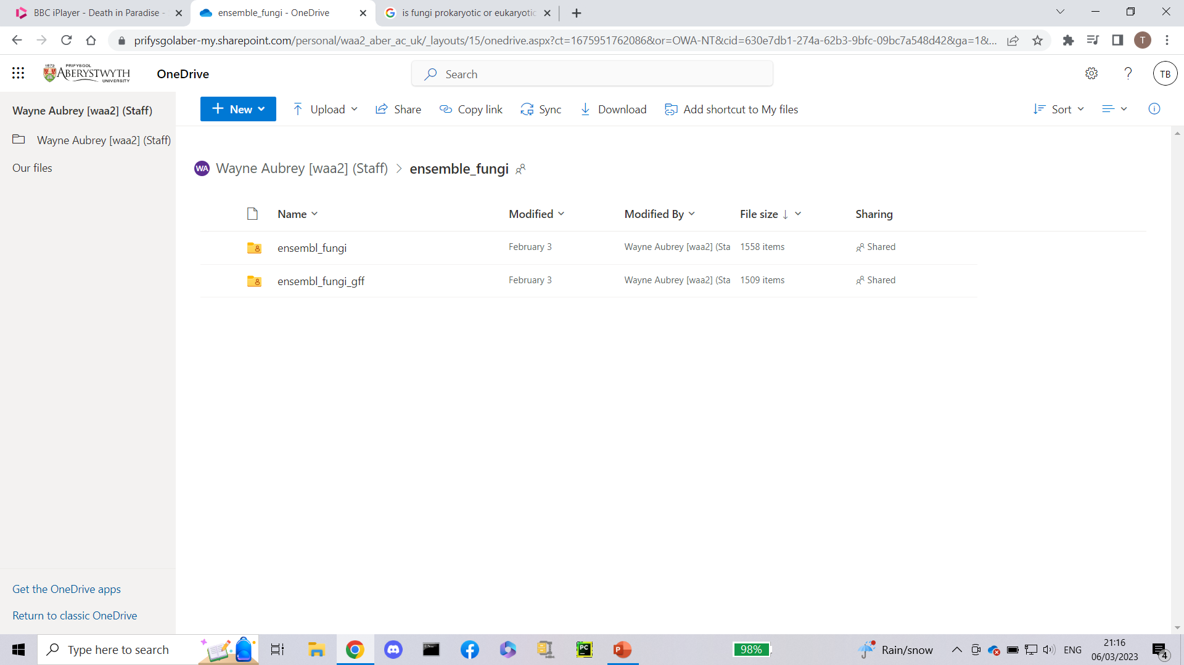
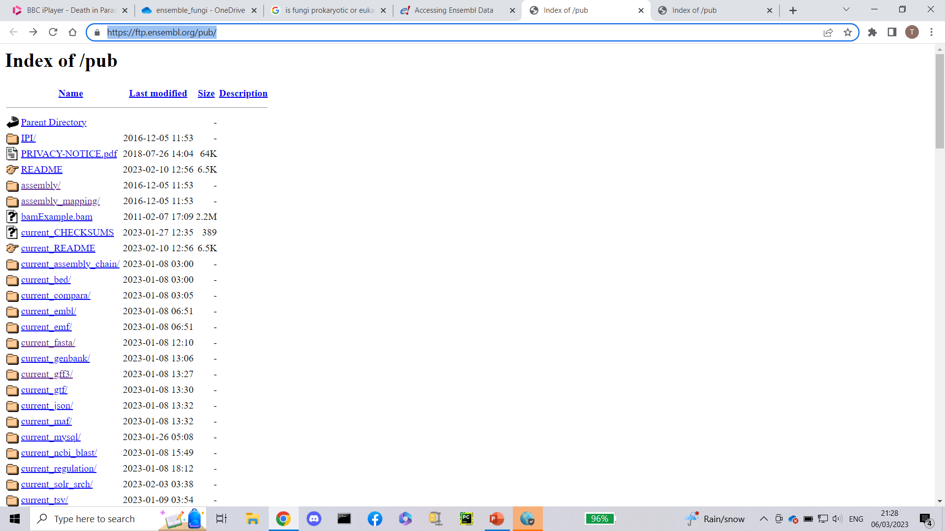
What data am I using
Ensembl DNA
https://ftp.ensembl.org/pub/
Notes:
I am using collection of profasta and gff files obtained from the ensemble.org website.
I was using the collection of files provided to me by Wayne via Onedrive however the fasta files were only the cds reads not the toplevel dna files so there were no tandem stop codons in the original files used. This was a set back in my project.
These files displayed are the ensemble fungi files provided to me at the start of the project.

Slide 8
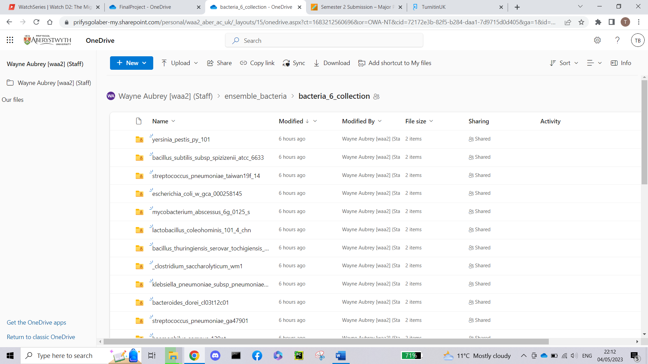
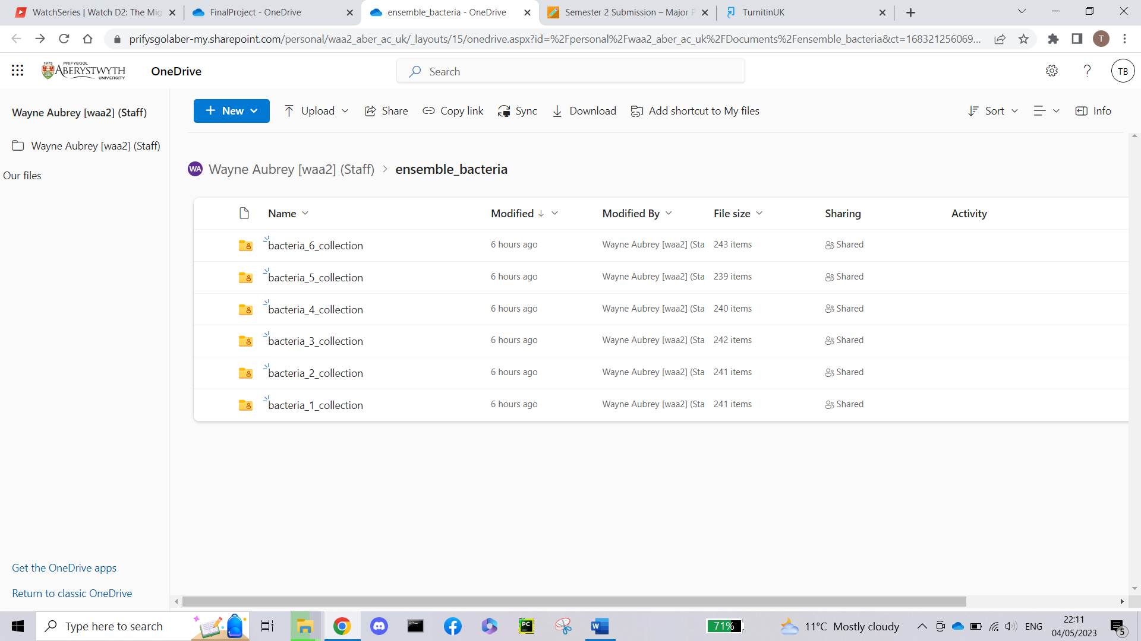
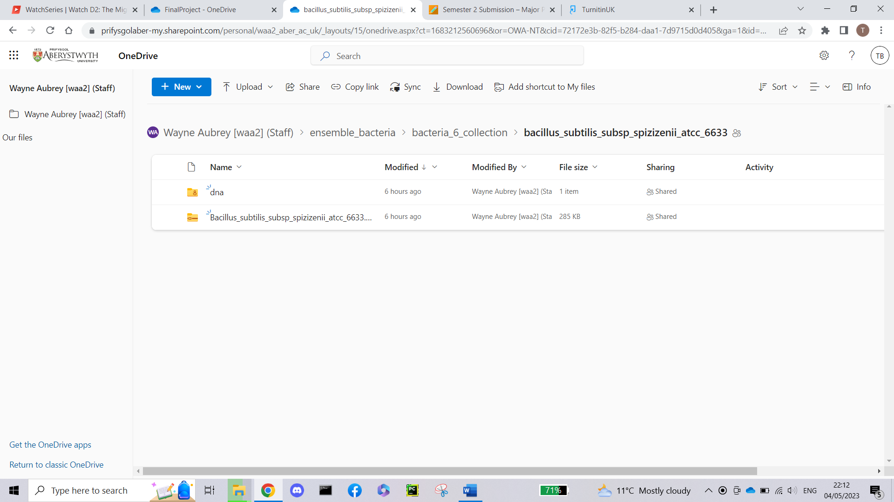
What data am I using
Ensembl DNA
Notes:
These file screenshots displayed are from the ensembl bacteria files provided to me at the end of the project. Unforntuality because of the directory format I couldn’t download a large about of them to run, however I was able to download a selection of them by hand.

Slide 9
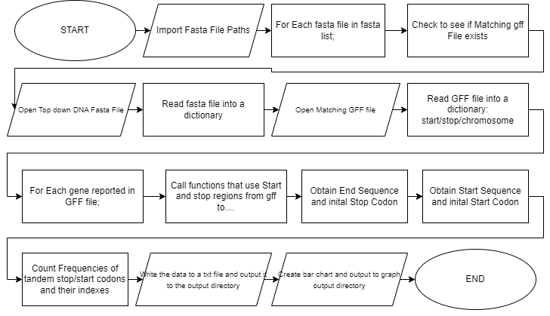
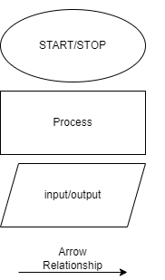
Flow chart for the Program
Key:
Notes:
This is a simple flow chart for the program I have written/ am currently working on to complete my project outcomes.

Slide 10
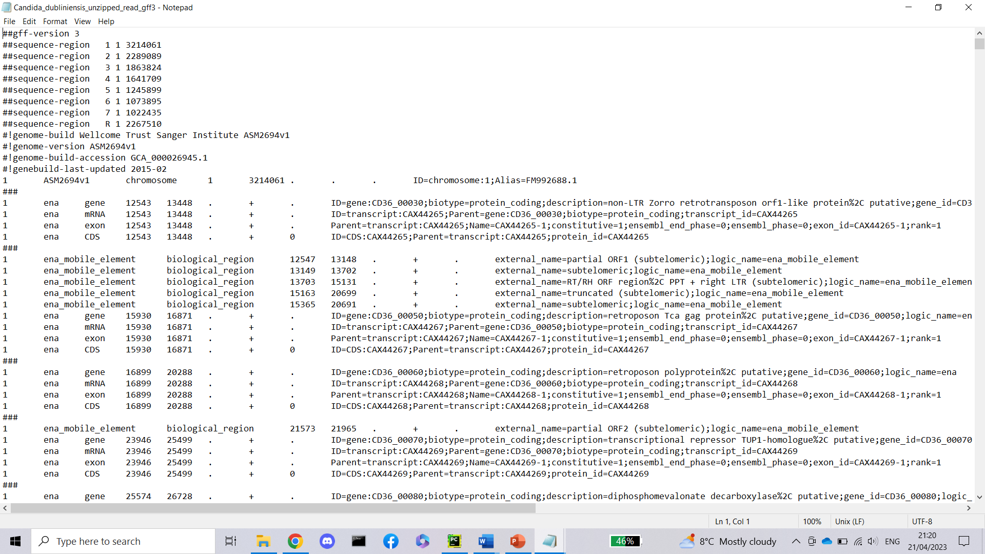
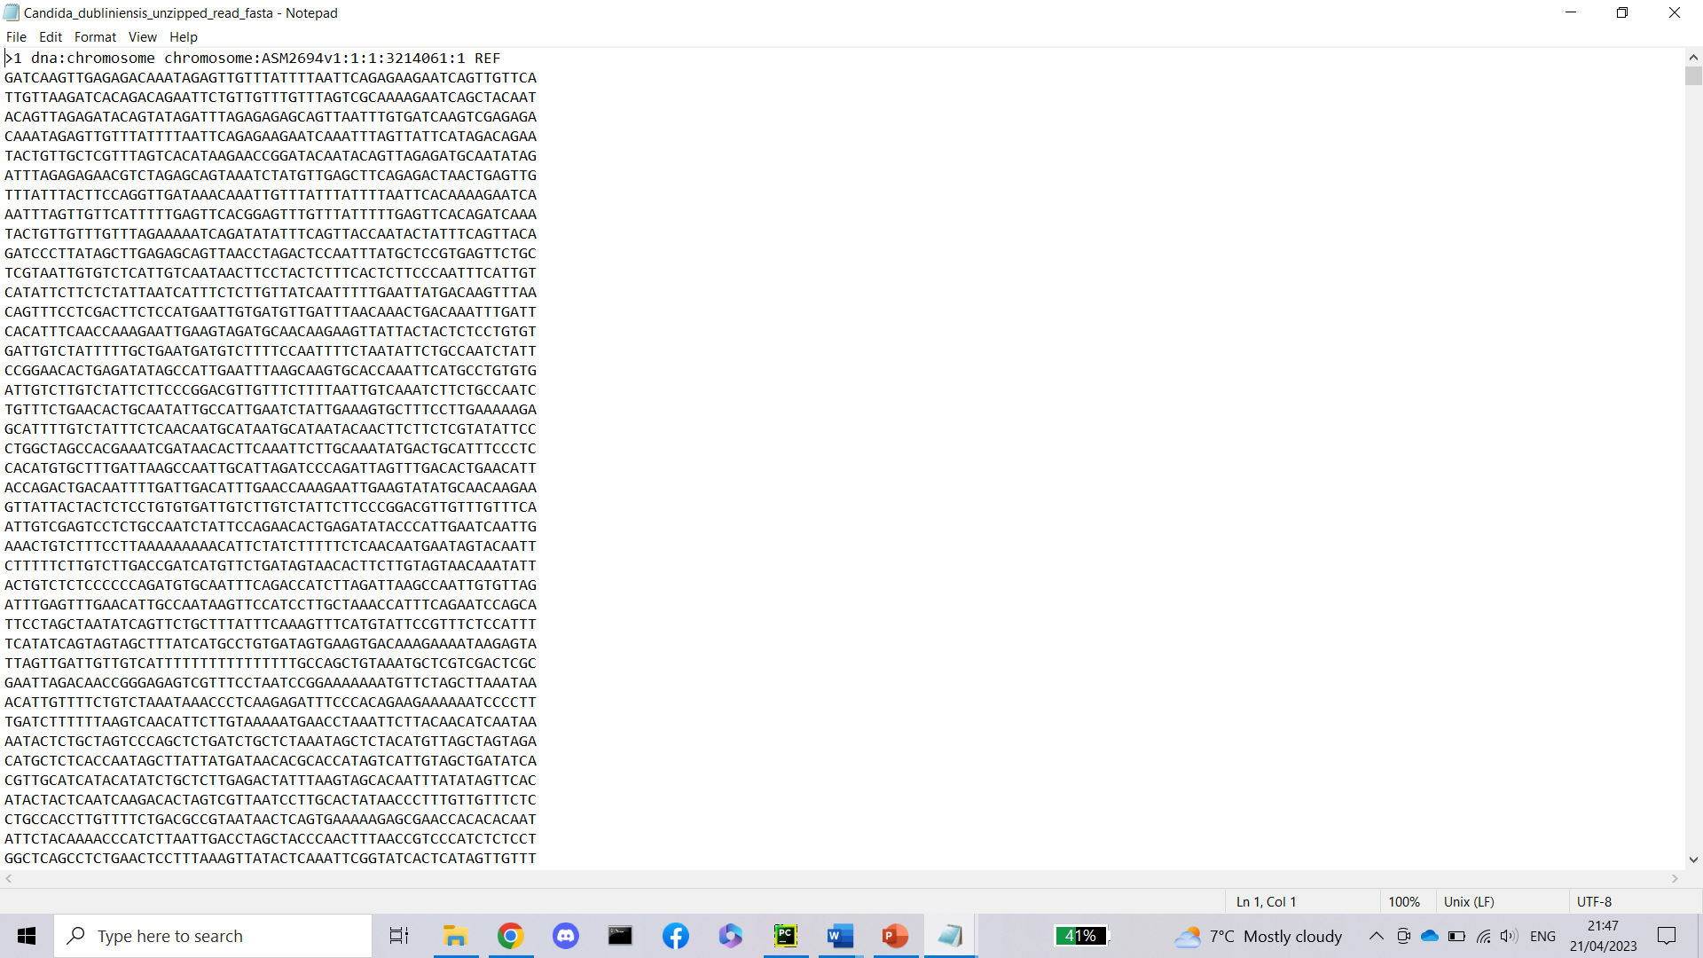














The Input
GFF
Top down dna fasta
Notes:
The information highlighted in yellow is what my program collects. From the gff files. In this example the 0th element is the chromosome is “1”, the 3rd element is the start region of the gene, and the 4th element is the stop region on the gene, the 8th element is the gene ID which I also record.
Highlighted in red is the strand the gene is on +/-. The reason this is highlighted in red is because give more time, I would implement a way of using this when extracting the information from the GFF file. However, my program does not currently do this.
For the fasta file I create a with the chromosome id blue as the key and the nucleotide sequence yellow as the value.

Slide 11
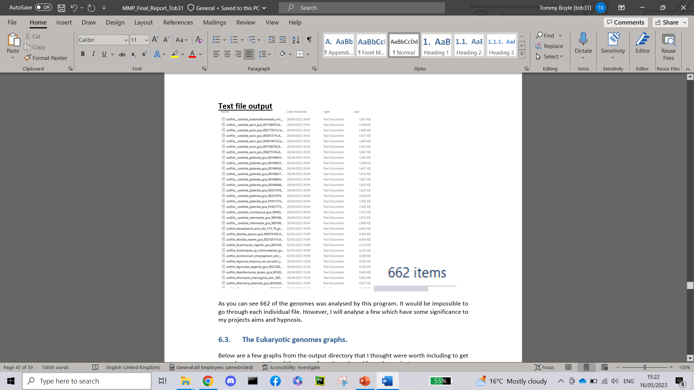
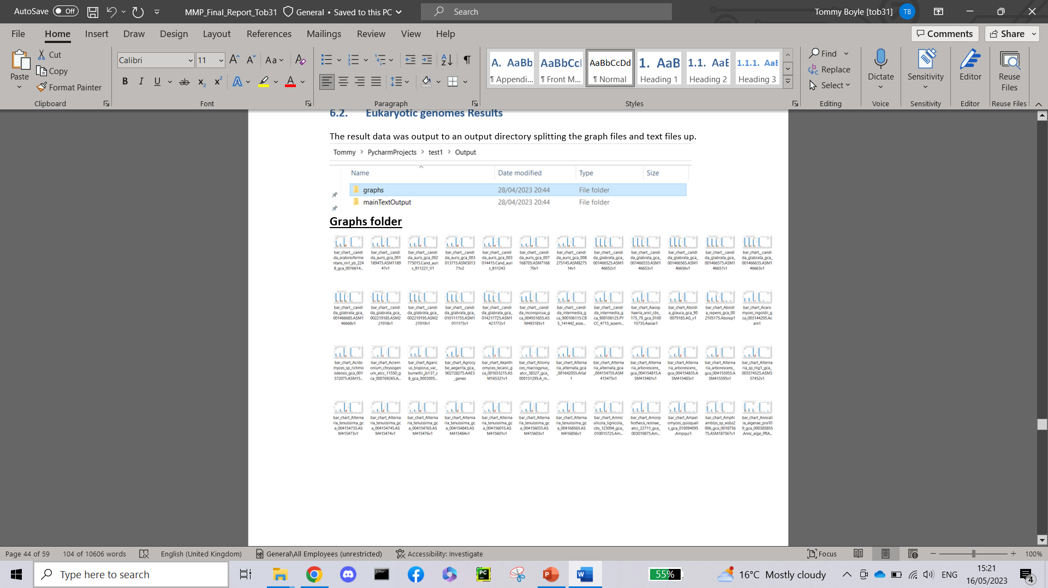
The output directory
Notes:
The output is sent to a directory path in the project file location, there are separate directors for both eukaryotic and prokaryotic. As you can see they are split up by there png graphs and text file output.
We will have a look at the results from the output and what it looks like later !!!

Slide 12
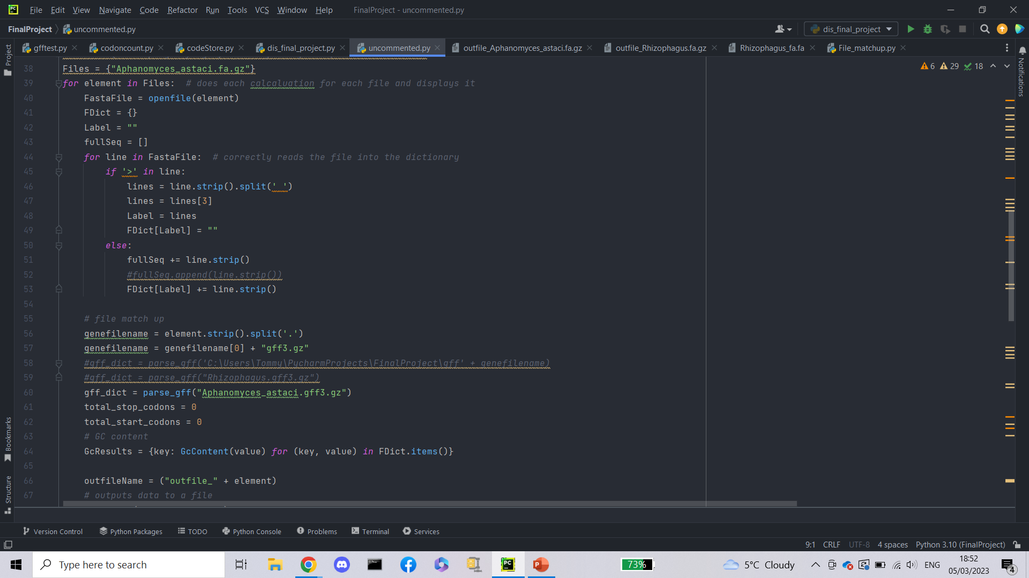
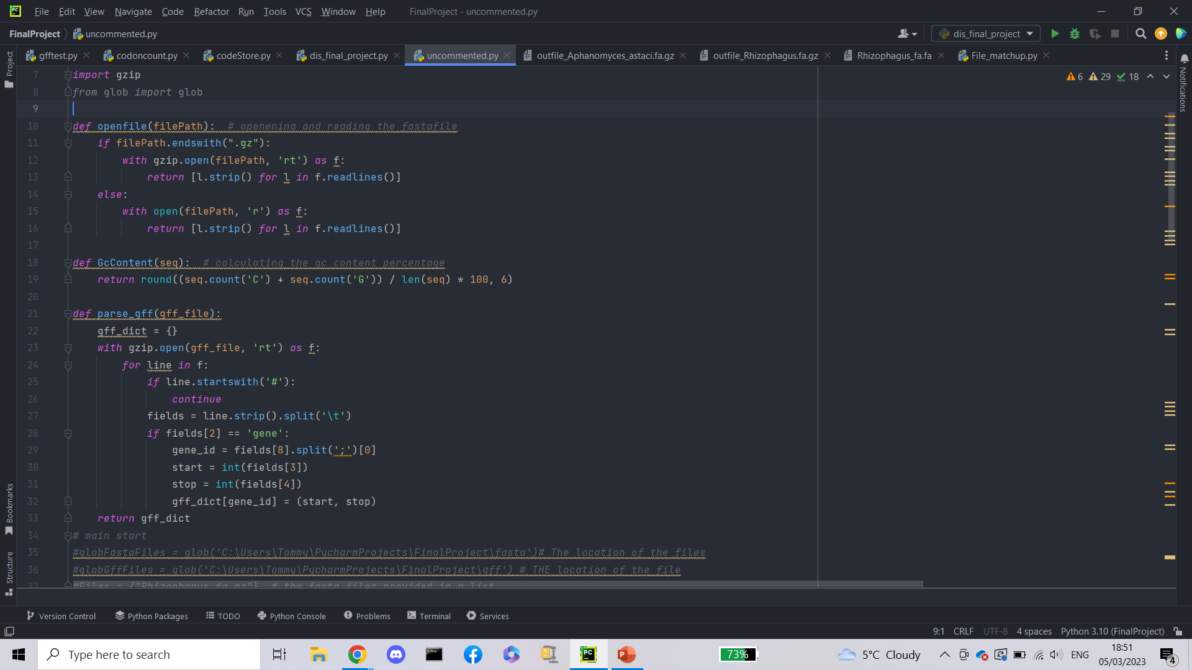
The actual Code
4.
1.
2.
3.
5.
Notes:
If time permits I can go through this code, or save it for the end if anyone has any questions about it.
Its, important to note that this code isn’t finished and I removed commented out code and other comments purely for this powerpoint.
Section…
1. Code for opening files checks to see if its gunziped or not
2.For calculating gc percentage
3.For opening gff files and reading them into a dictionary with start and top regions as values and gene as the key
4.For reading in the fasta files into a dictionary
5. For matching up the correct gff file to the fasta file

Slide 13
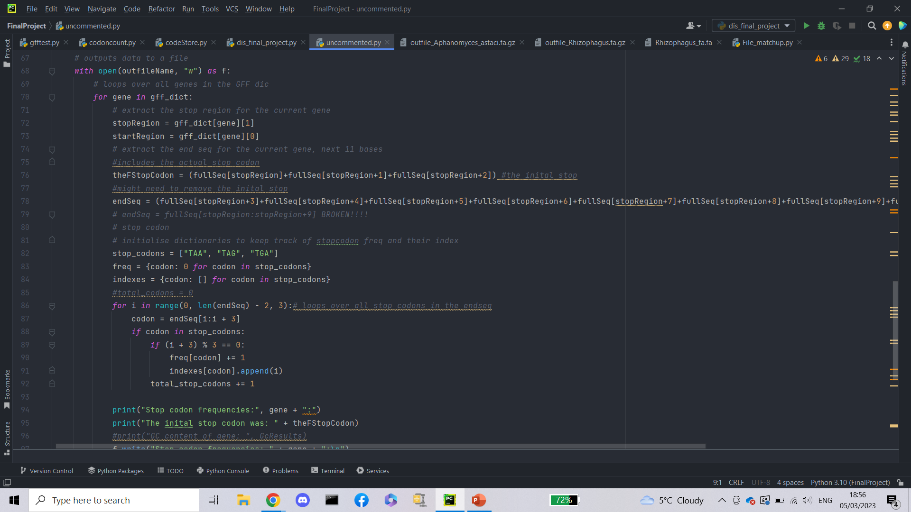
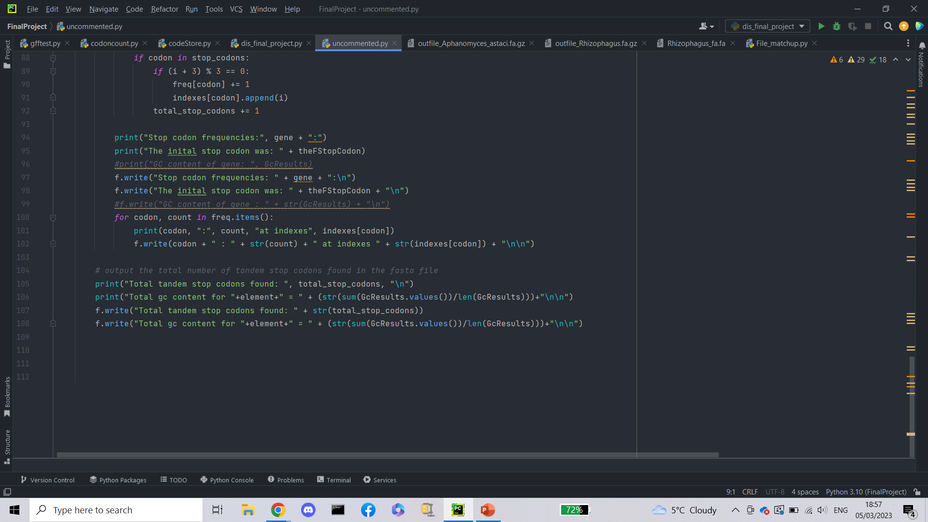
All of this code is purely for this demo and does not represent the final version
6.
7.
8.
Notes:
6. Is for obtaining the sequence that contains the tandem stop codons
7. Is for iterating through the list of stop codons and recording the frequency and index in dictionarys
8. Is for outputting the data. Printing to the screen and also writing to a file

Slide 14
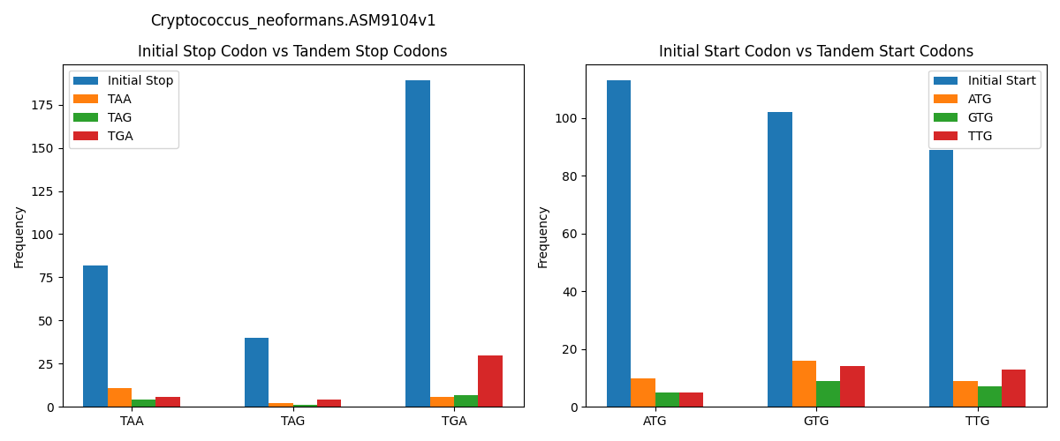
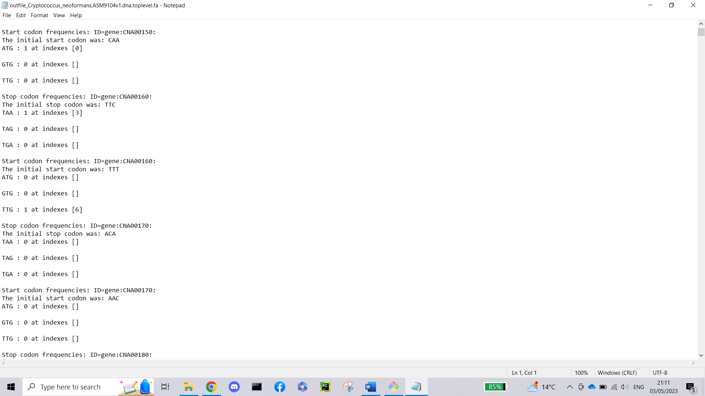
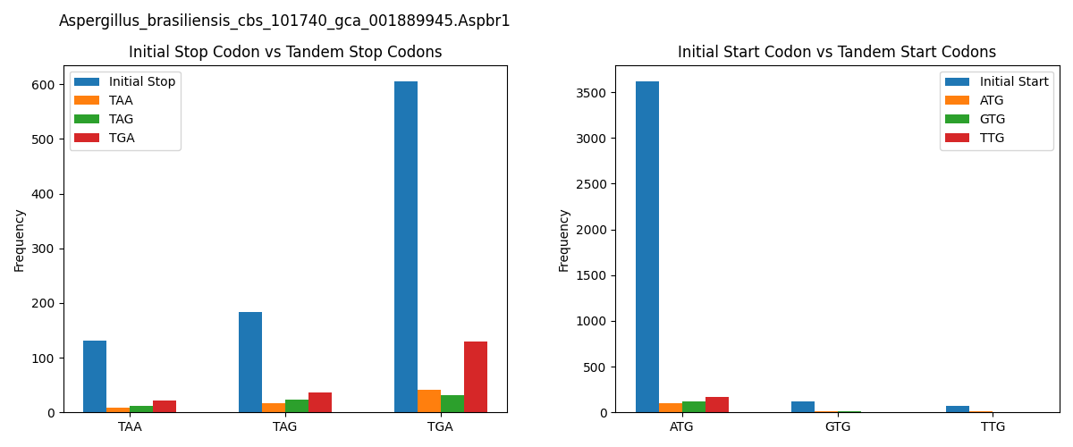
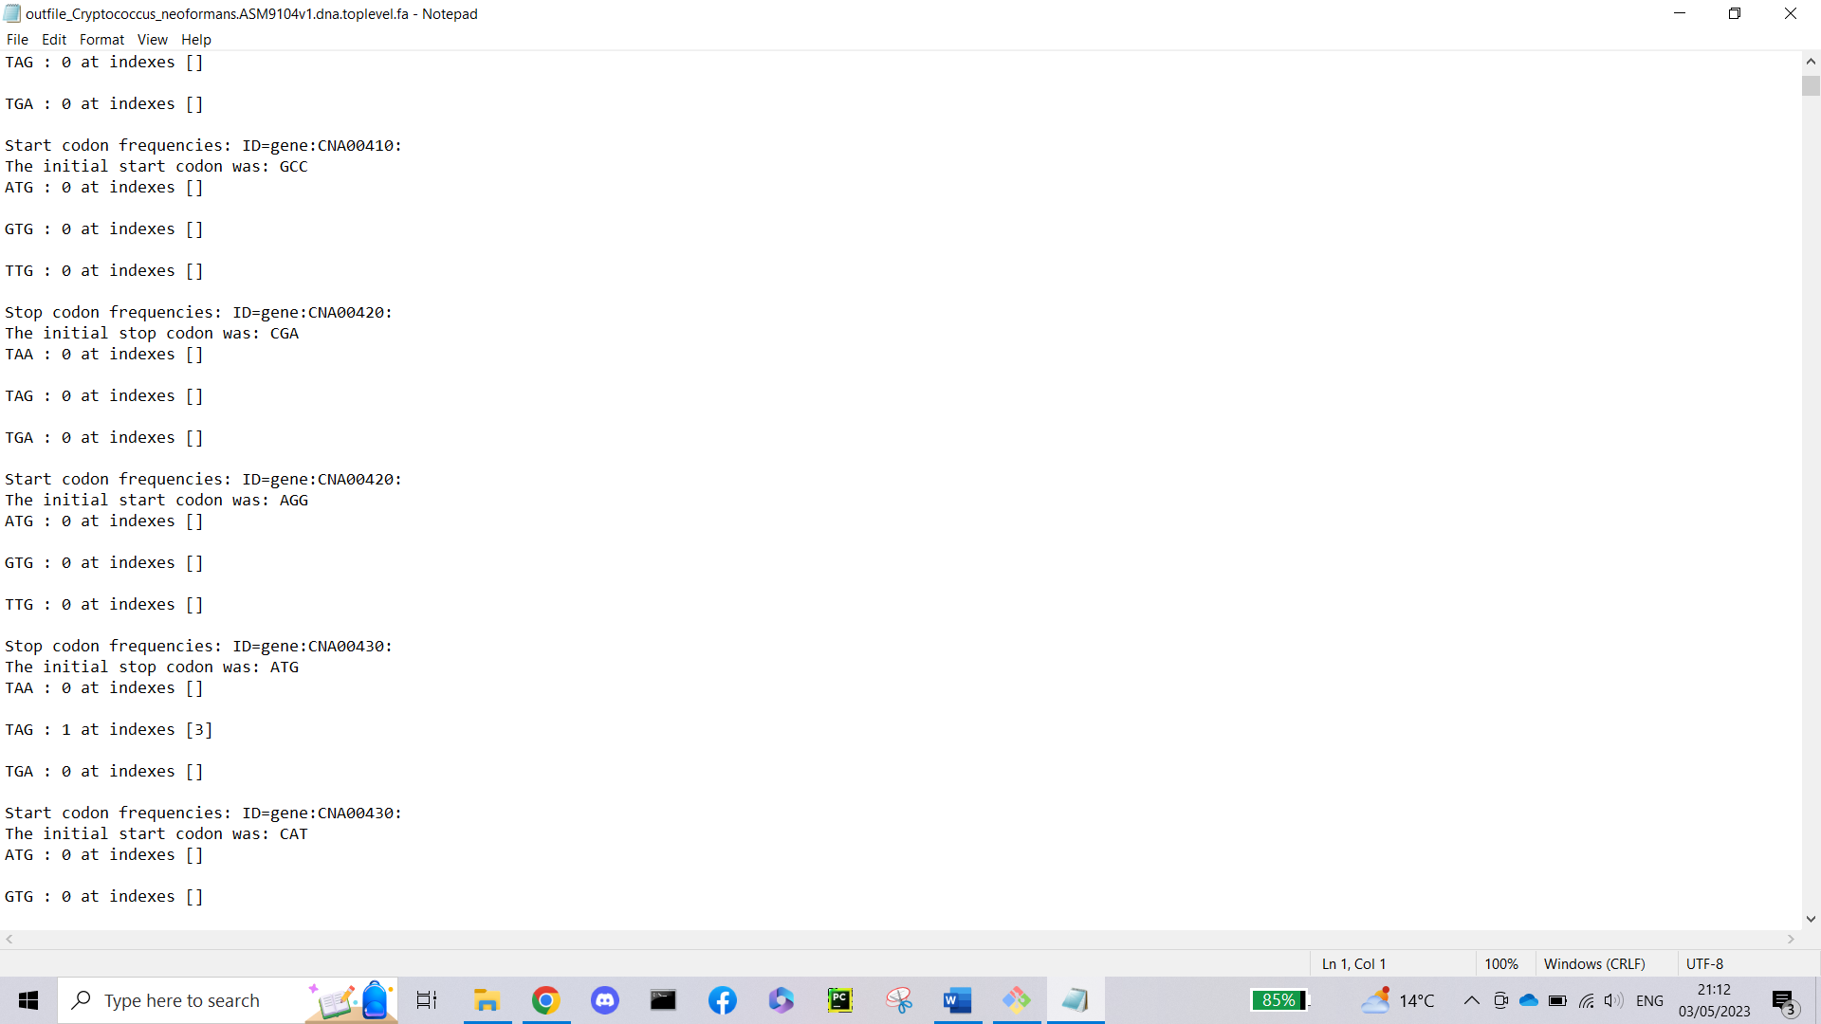
Eukaryotic Output
Notes:
This is how the output looks. From the text file on the left here we can see a start/stop codon founds with their initial codon recorded as well as the index is was found at.
Its important to note that for these examples the initial codon found was not a valid codon. However from discussion with wayne. I was advided to leave them in the text file output.
Further more when looking at the graphs. This is not the case since only valid initial codons with valid tandem stop codons are recorded and represent on the graph.
Lets look at the results now. Its important to note I have only include 2 graphs for size reasons, there are more to look at in my report and also the output directory as all of them.
As we can see from these graphs TGA is by far the most common stop codon used on these eukaryotic genomes but not only that TGA is also by far the most common tandem stop codon used by the other initial stop codon.
As for start codons these graphs confirm their existence in the 12 bases before the initial start codon, ATG is by far the most common start codon used on these eukaryotic genomes and not only that, but the most common tandem start codon is TTG. When looking at other graphs.
Looking at the Cryptococcus genome, this genome almost equally use all start codons for their genes in huge contrast to other eukaryotic genomes but not only that when looking at their tandem start codons used, the most common tandem start codon is the same as the initial codon for this genome.

Slide 15
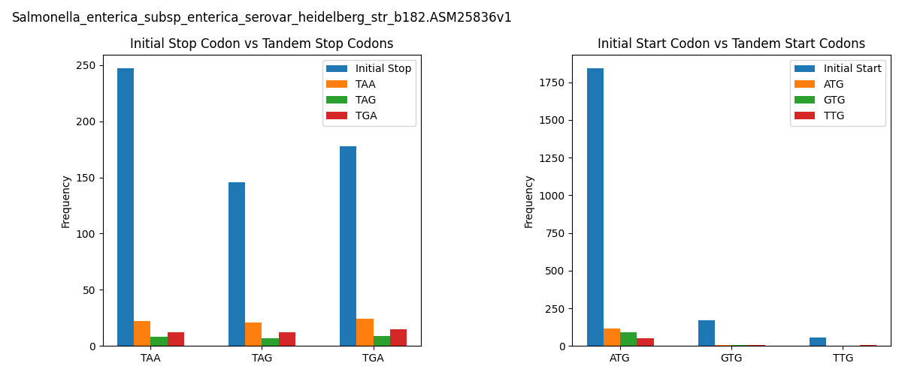
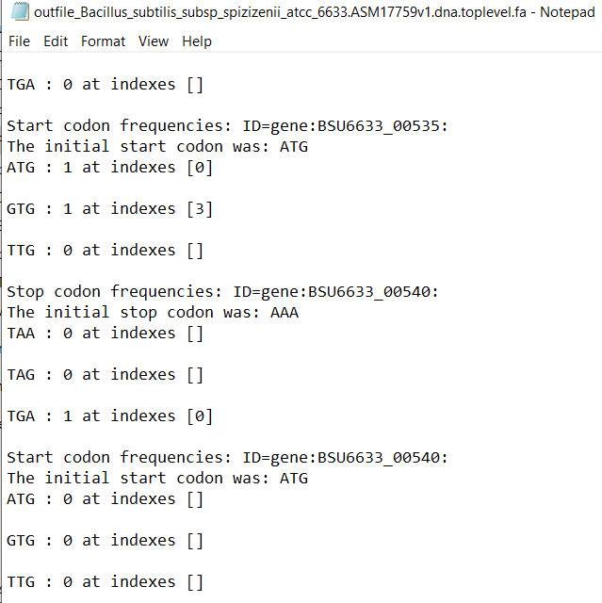
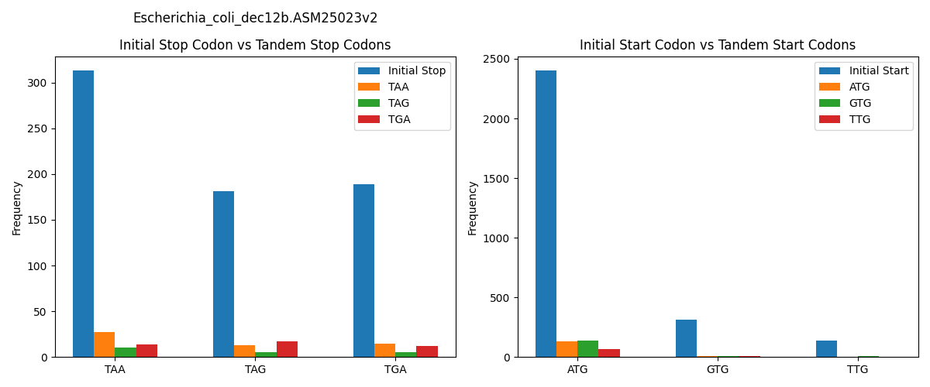
Prokaryotic Output
Notes:
When Looking stop codons data from these files we can see that these prokaryotic genomes have a clear preference for the TAA stop codon but not only that when looking at the frequency of tandem stop codons we can also see a clear preference for the TAA codon as a tandem stop codon
When looking at the start codons data from these files we can see a similar preference of ATG as the main initial start codon.
However, we can see that the preferred tandem start codon is also ATG the same as the initial this is difference from the eukaryotic genomes which had a preference for TTG as its tandem start codon.
We can also variation based on genome to, when looking at bacillus subtillus there is a higher frequency of GTG start codons although it isn’t the most preferred initial start codon its certainly the most preference tandem for this genome, and the second most preferred initial start behind ATG.

Slide 16
Early Timeline
2023
Jan
Feb
Mar
Apr
May
2023
Today
project
Jan 29 - May 2
Reasearch
Jan 30
read in fasta files
Feb 4
read in gff files
Feb 11
extract start and stop regions from gff
Feb 20
reference stop region from fasta file
Feb 25
count tandem stop codon freq
Mar 1
tandem start codon freqencey?
Mar 11
output data to txt file
Mar 17
data visulisation
Apr 12
Notes:
This was an early timeline for my project with objectives I need to complete. By the end of the project all of these objects were met on time.

Slide 17
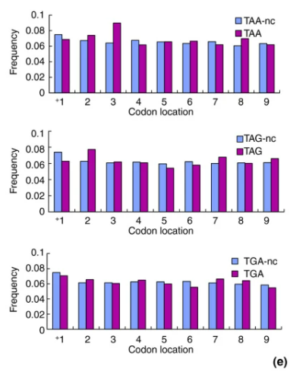

Future objectives given more time
Notes:
When comparing my graphs from the graphs from the paper, the conservation of tandem stop codons in yeasts you can see they include the Indexes on the graphs which is something could include as future problem to solve since my program already records the indexes for the text file output.
Also taking in the strand end from gene in the gff file could be a good addition to this program and potentially solve why there are so many invalid codons found at the start/stop regions provided.
Developing a Graphical user interface would be ideal for biologist users who lack the technical experience to use this program, this gui could ask the users to provide the file paths to the fasta and gff files. Then the program could run and give the user the option to look at the graph produced or potentially each gene or all the genes with tandem codons.

Slide 18
Technical problems

Slide 19
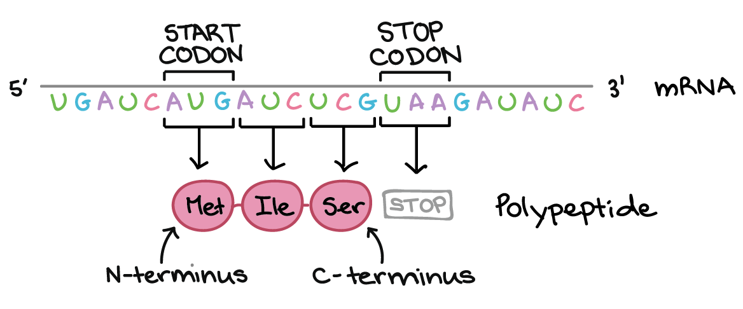
Any Questions?
Thank you
for listening
Notes:
Conservation of tandem stop codons in yeasts
Liang, H., Cavalcanti, A.R. & Landweber, L.F. Conservation of tandem stop codons in yeasts. Genome Biol 6, R31 (2005). https://doi.org/10.1186/gb-2005-6-4-r31

